Slide 1
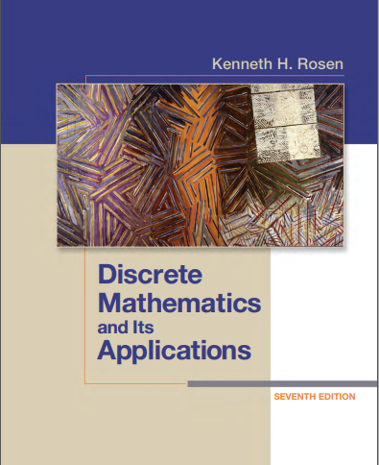

Discrete structures
By Dr. sajid iqbal
Course Reference Book

Slide 2
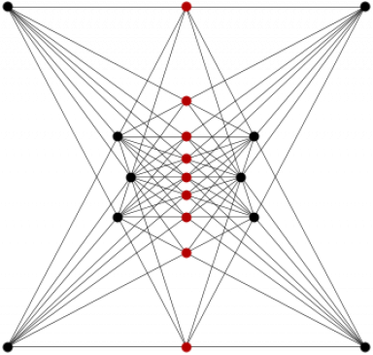
Applications of Propositional Logic
Chapter - 1

Slide 3
Background
Statements written in mathematical form or in natural language are often ambiguous and imprecise
I appreciate the hardworking student
Logic provides the way to create correct and precise statements that can be translated into Computer Program
There are numerous applications where logical rules play their role
There are applications which can automatically provide the proof of theorems

Slide 4
natural language processing
Natural Language Processing
Natural Language Understanding
Dialogue Management
Natural Language Generation
Translating English Sentences
Natural language processing (NLP) one of the major area of Artificial Intelligence
Natural language is inherently ambiguous
To remove ambiguity, English text and sentences need to be converted to concise propositional statements
Truth values can be easily found for a sentence transformed into logical propositions

Slide 5

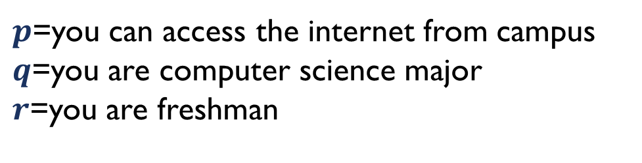
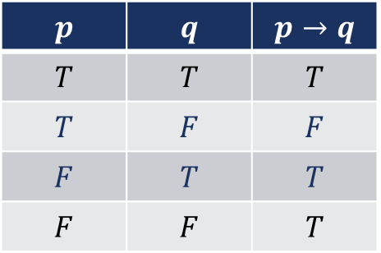
natural language processing
Example -1: “You can access the Internet from campus only if you are a computer science major or you are not a freshman”
Break the sentence into smaller facts that could be called proposition
$$p → (q ∨ ¬r )$$
$$p$$ | $$q$$ | $$p→q$$
$$T$$ | $$T$$ | $$T$$
$$T$$ | $$F$$ | $$F$$
$$F$$ | $$T$$ | $$T$$
$$F$$ | $$F$$ | $$T$$
$p$=you can access the internet from campus
$q$=you are computer science major
$r$=you are freshman

Slide 6


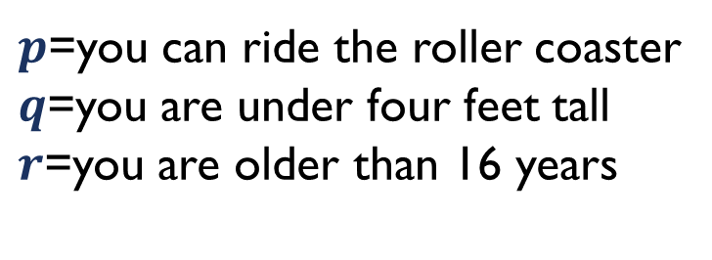
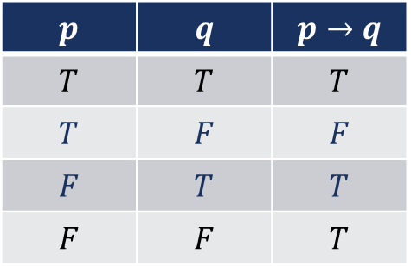
natural language processing
Example-2: “You cannot ride the roller coaster if you are under 4 feet tall unless you are older than 16 years old “
$$(q ∧ ¬r) → ¬p$$
$$p$$ | $$q$$ | $$p→q$$
$$T$$ | $$T$$ | $$T$$
$$T$$ | $$F$$ | $$F$$
$$F$$ | $$T$$ | $$T$$
$$F$$ | $$F$$ | $$T$$
$p$=you can ride the roller coaster
$q$=you are under four feet tall
$r$=you are older than 16 years

Slide 7

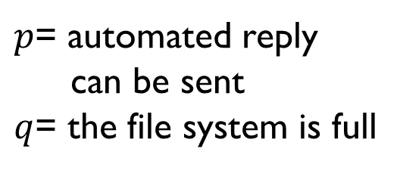
System Specifications
Any real life problem is first described in Natural Language and then it is specified into logical prepositions
System specifications need to be consistent
A consistent specification does not contain conflicting requirements
Algorithms, Hardware Systems, Software Systems
Example-1: Express the specification “The automated reply cannot be sent when the file system is full” using logical connectives
$$q → ¬p$$
$p$= automated reply
can be sent
$q$= the file system is full

Slide 8
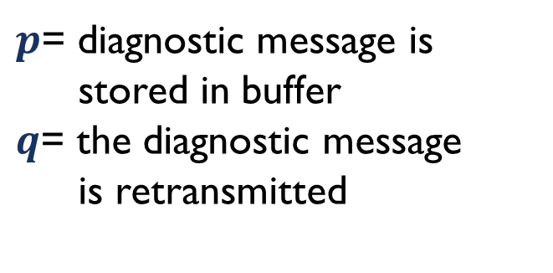
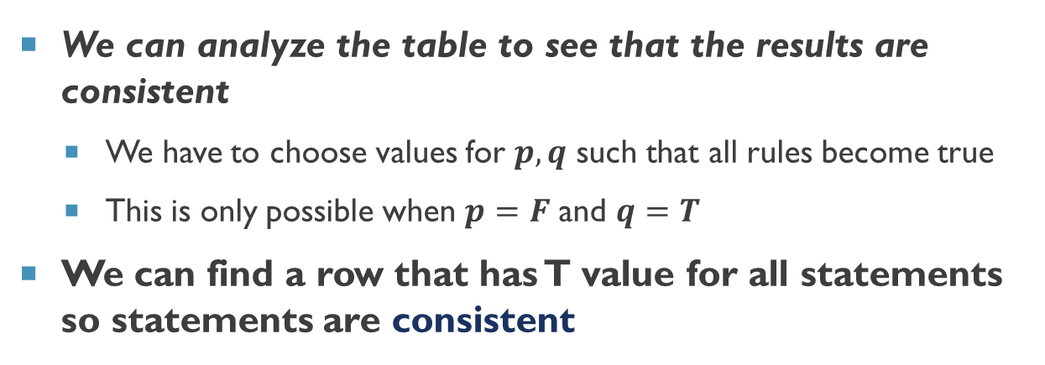
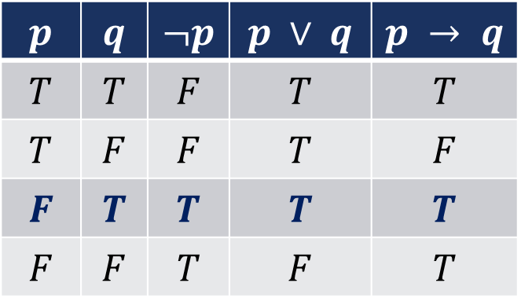
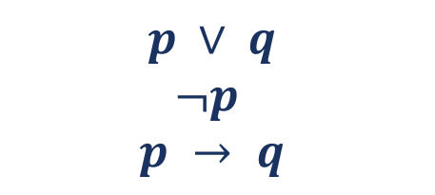
System Specifications
Example-2: Determine whether system specification is consistent or not
“The diagnostic message is stored in the buffer or it is retransmitted.”
“The diagnostic message is not stored in the buffer.”
“If the diagnostic message is stored in the buffer, then it is retransmitted.”
$$p ∨ q$$
$$¬p$$
$$p → q$$
$p$= diagnostic message is
stored in buffer
$q$= the diagnostic message
is retransmitted
We can analyze the table to see that the results are consistent
We have to choose values for $p,q$ such that all rules become true
This is only possible when $p=F$ and $q=T$
We can find a row that has T value for all statements so statements are consistent
$$p$$ | $$q$$ | $$¬p$$ | $$p ∨ q$$ | $$p → q$$
$$T$$ | $$T$$ | $$F$$ | $$T$$ | $$T$$
$$T$$ | $$F$$ | $$F$$ | $$T$$ | $$F$$
$$F$$ | $$T$$ | $$T$$ | $$T$$ | $$T$$
$$F$$ | $$F$$ | $$T$$ | $$F$$ | $$T$$

Slide 9
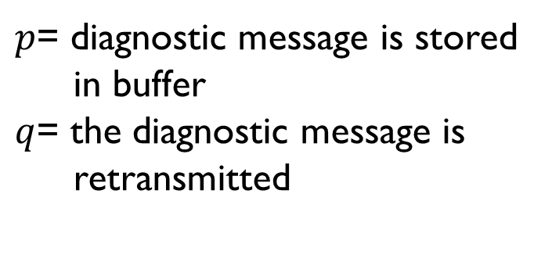
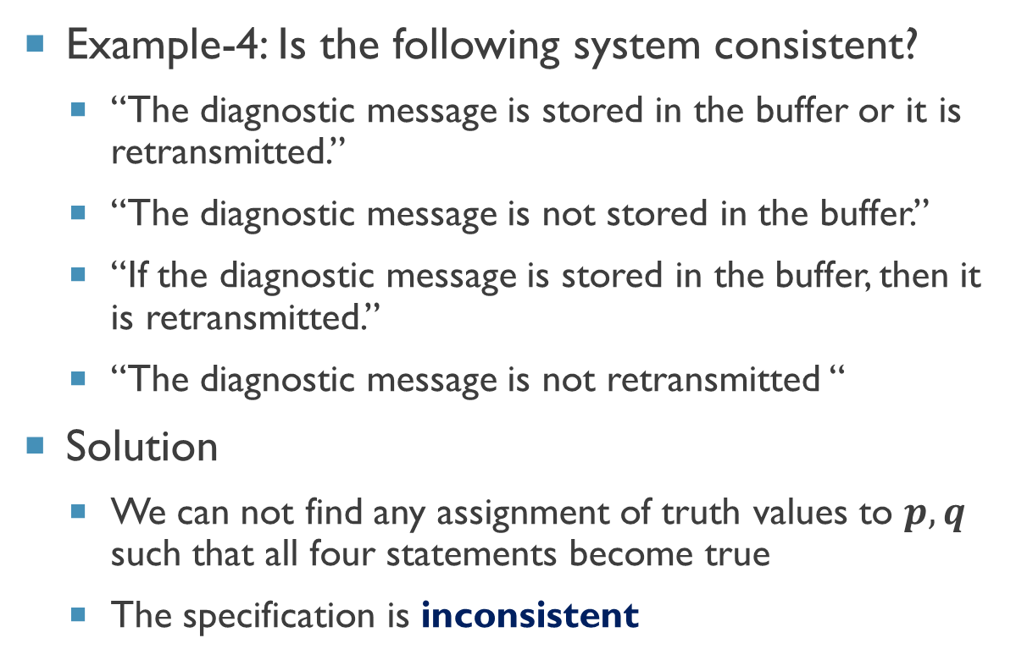
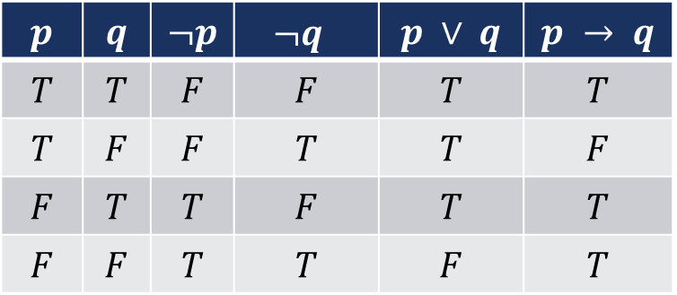
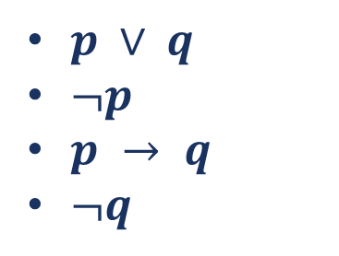
System Specification
Example-4: Is the following system consistent?
“The diagnostic message is stored in the buffer or it is retransmitted.”
“The diagnostic message is not stored in the buffer.”
“If the diagnostic message is stored in the buffer, then it is retransmitted.”
“The diagnostic message is not retransmitted “
Solution
We can not find any assignment of truth values to $p,q$ such that all four statements become true
The specification is inconsistent
$p ∨ q$
$¬p$
$p → q$
$¬q$
$p$= diagnostic message is stored
in buffer
$q$= the diagnostic message is
retransmitted
$$p$$ | $$q$$ | $$¬p$$ | $$¬q$$ | $$p ∨ q$$ | $$p → q$$
$$T$$ | $$T$$ | $$F$$ | $$F$$ | $$T$$ | $$T$$
$$T$$ | $$F$$ | $$F$$ | $$T$$ | $$T$$ | $$F$$
$$F$$ | $$T$$ | $$T$$ | $$F$$ | $$T$$ | $$T$$
$$F$$ | $$F$$ | $$T$$ | $$T$$ | $$F$$ | $$T$$

Slide 10
Boolean searches
Boolean searches use propositional logic techniques
Logical connectives are highly used in web searches
These are also used in offline searches
Example:
Boolean searching to find Web pages about universities in LAHORE, we can look for pages matching LAHORE AND UNIVERSITIES.
The results of this search will include those pages that contain the three words LAHORE and UNIVERSITIES
A
B
A and B
A
B
A or B
A
B
A not B

Slide 11
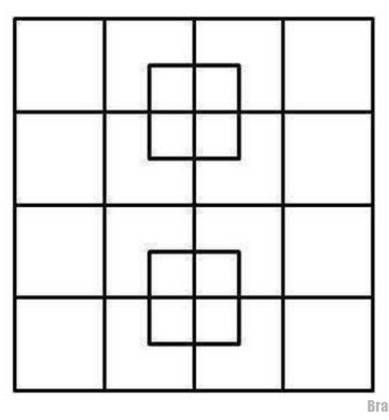
Logic puzzles
Puzzles that are solved using logic rules
Solving logic puzzles is an excellent way to practice working with the rules of logic
Computer programs designed to carry out logical reasoning often use well-known logic puzzles to illustrate their capabilities.

Slide 12
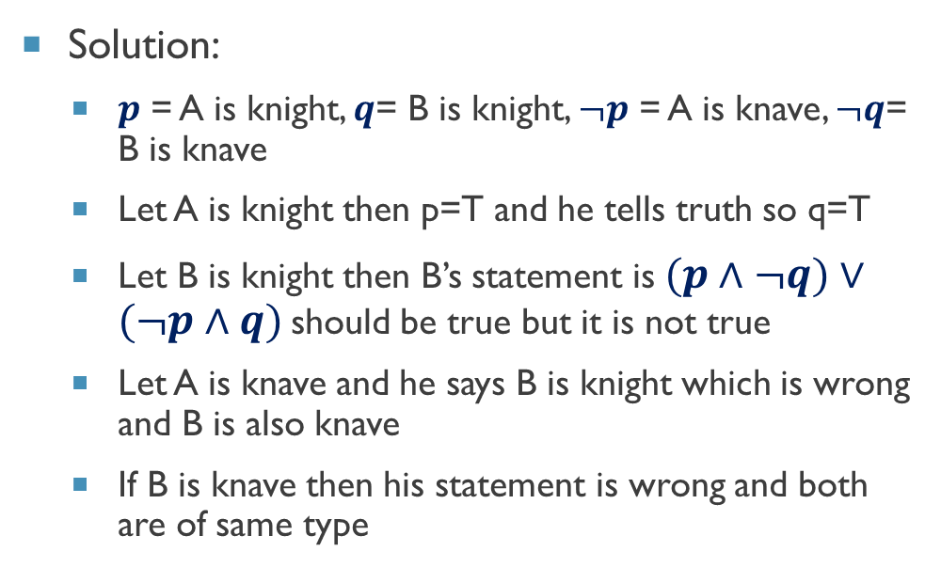
Logic puzzles - Example
Let there is an island where two type of people live “knights” and “knaves”. Knights always tell the truth whereas knaves always tell the lie.
You meet two people A and B.
A says B is “knight”
B says “We both are of opposite type”
Solution:
$p$ = A is knight, $q$= B is knight, $¬p$ = A is knave, $¬q$= B is knave
Let A is knight then p=T and he tells truth so q=T
Let B is knight then B’s statement is $(p∧¬q)∨(¬p∧q)$should be true but it is not true
Let A is knave and he says B is knight which is wrong and B is also knave
If B is knave then his statement is wrong and both are of same type

Slide 13
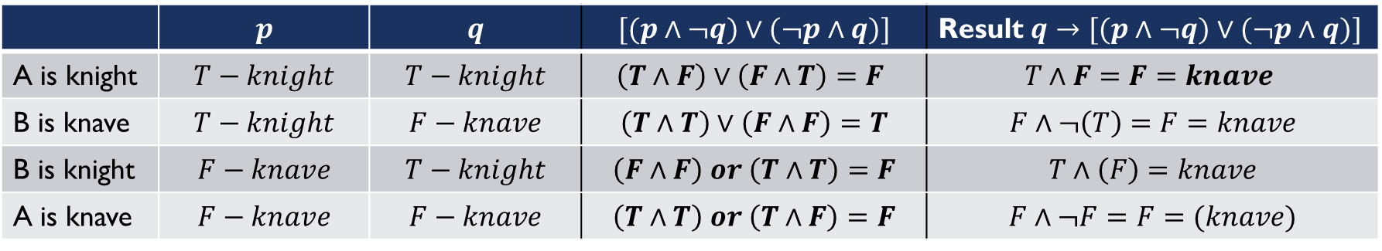
$p$ = A is knight, $q$= B is knight, $¬p$ = A is knave, $¬q$= B is knave $T$=knight $F$=Knave
A says B is “knight”
B says “We both are of opposite type”
 | $$p$$ | $$q$$ | $$[(p∧¬q)∨(¬p∧q)]$$ | Result $q→[(p∧¬q)∨(¬p∧q)]$
A is knight | $$T−knight$$ | $$T−knight$$ | $$\left(T∧F\right)∨\left(F∧T\right)=F$$ | $$T∧F=F=knave$$
B is knave | $$T−knight$$ | $$F−knave$$ | $$\left(T∧T\right)∨\left(F∧F\right)=T$$ | $$F∧¬\left(T\right)=F=knave$$
B is knight | $$F−knave$$ | $$T−knight$$ | $$\left(F∧F\right) or \left(T∧T\right)=F$$ | $$T∧\left(F\right)=knave$$
A is knave | $$F−knave$$ | $$F−knave$$ | $$\left(T∧T\right) or \left(T∧F\right)=F$$ | $$F∧¬F=F=(knave)$$
If A=knight then B is knight, and B’s statement must be False
If B=knight then A is knave as knight speak truth, B ‘s statement must be true but is False
If A=knave then B is knave
If B=knave then A is also knave (as B tells lie)

Slide 14


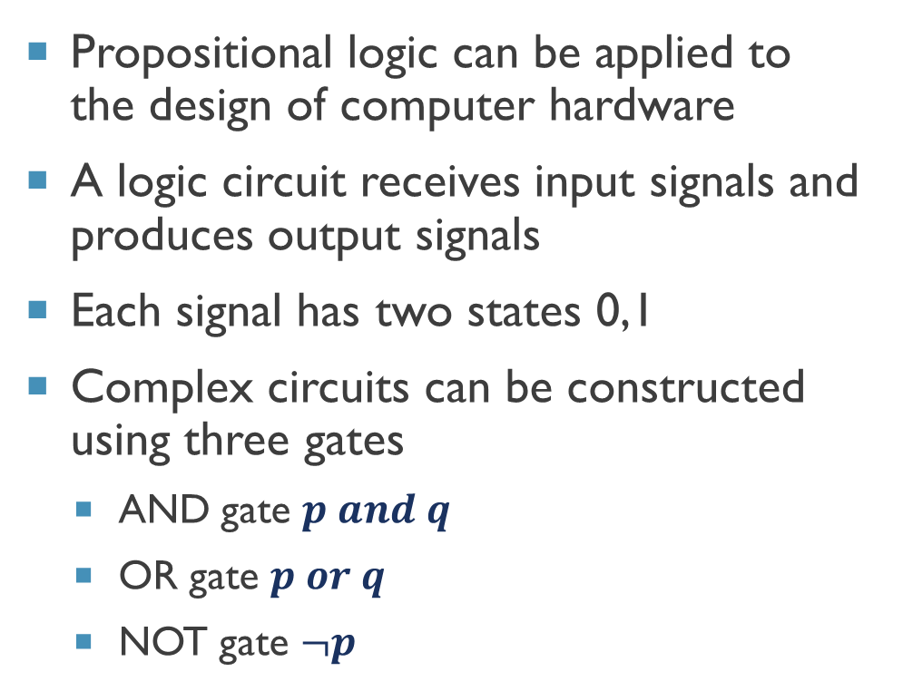
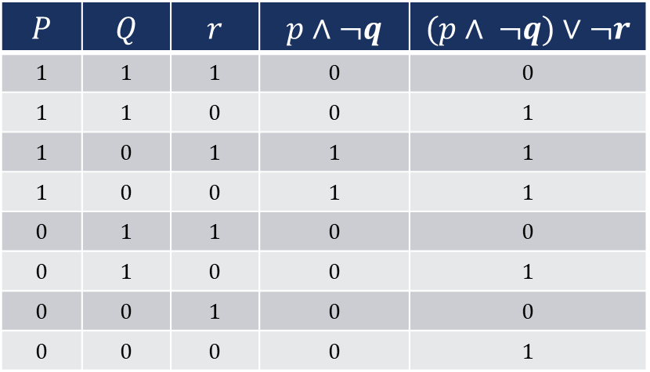
Logic Circuits
Propositional logic can be applied to the design of computer hardware
A logic circuit receives input signals and produces output signals
Each signal has two states 0,1
Complex circuits can be constructed using three gates
AND gate $p and q$
OR gate $p or q$
NOT gate $¬p$
$$P$$ | $$Q$$ | $$r$$ | $$p∧¬q$$ | $$(p∧ ¬q)∨¬r$$
$$1$$ | $$1$$ | $$1$$ | $$0$$ | $$0$$
$$1$$ | $$1$$ | $$0$$ | $$0$$ | $$1$$
$$1$$ | $$0$$ | $$1$$ | $$1$$ | $$1$$
$$1$$ | $$0$$ | $$0$$ | $$1$$ | $$1$$
$$0$$ | $$1$$ | $$1$$ | $$0$$ | $$0$$
$$0$$ | $$1$$ | $$0$$ | $$0$$ | $$1$$
$$0$$ | $$0$$ | $$1$$ | $$0$$ | $$0$$
$$0$$ | $$0$$ | $$0$$ | $$0$$ | $$1$$

Slide 15



Thanks for watching
Dr. Sajid Iqbal
Assistant Professor
Department of Computer Science
Bahauddin Zakariya University, Multan
sajidiqbal.pk@gmail.com
https://github.com/sajjo79/DiscreteMathematics
Allah Hafiz
COMEDXD

